Slide 1
64tran
Presented by Team Fourtran

Slide 2
9 Questions
Do you think all programs should be written in a terminal?
Did you spend most of your time programming in Assembly for MS Dos?
Do you think all identifiers should be 8 characters or fewer?
Do the words “object-oriented programming” scare you?
Do you think Fortran is the greatest programming language ever?
Are you fat…
Old…
Ugly…
And Armenian?

Slide 3
Just leave now!

Slide 4
What do we have?
Types (string, integer, real, boolean, routine?)
Routines (okay, right now it’s just print)
Scopes for days
NEWLINE based statements
Control Statements (IF and WHILE)
Operator precedence
Operator overloading?!
OBJECTS WITH FIELDS AND METHODS?!

Slide 5
Everything is an object!
Integers are objects
Reals are objects
Strings are objects
Types are objects? (well, no, not yet)

Slide 6

EVERYONE GETS AN OBJECT!

Slide 7
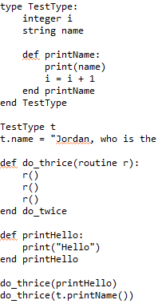
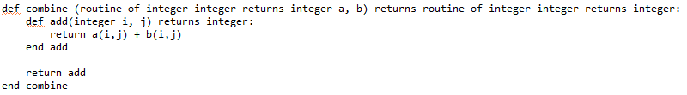
Routines are objects!

Slide 8
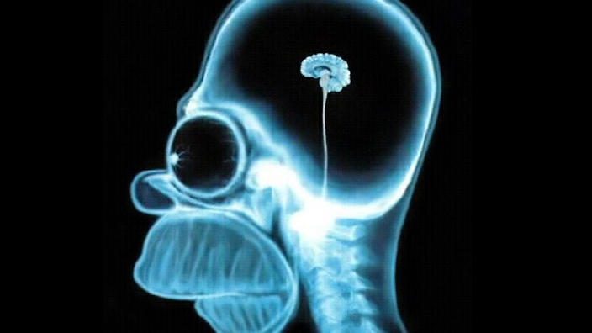
Your brain:

Slide 9
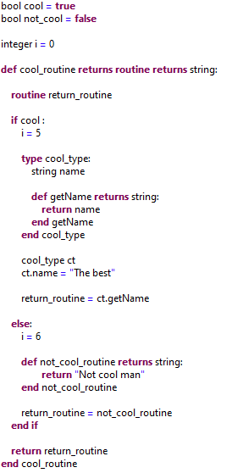
Coolest Thing Ever:

Slide 10
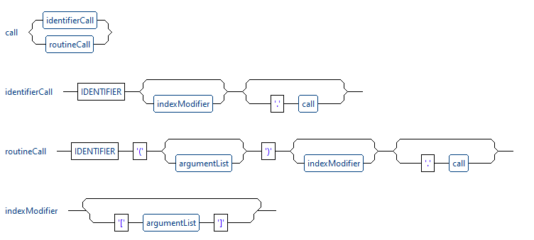
Call Me Maybe actually call me ambulance because working on the call semantics cost me most of my sanity

Slide 11
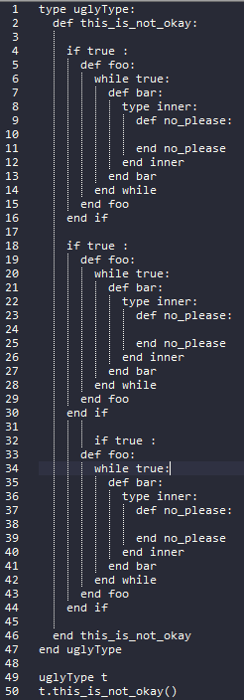
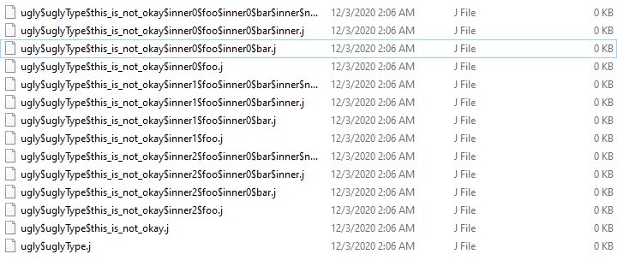
Object Code for an Object-Oriented Language
Social Distancing dictates that each routine gets its own class file
This can lead to some class names that aren’t pretty

Slide 12
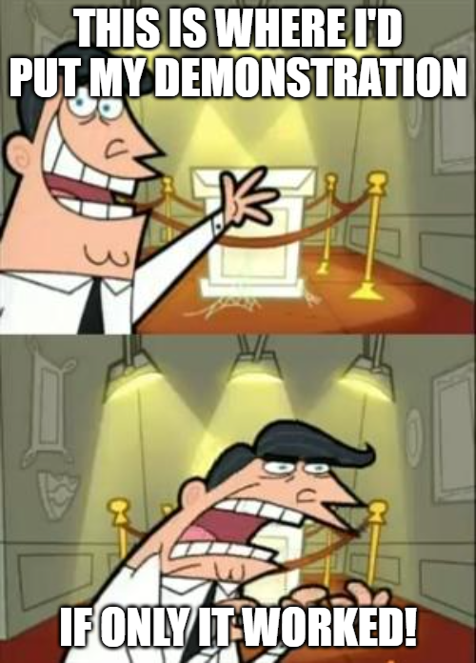

Slide 13
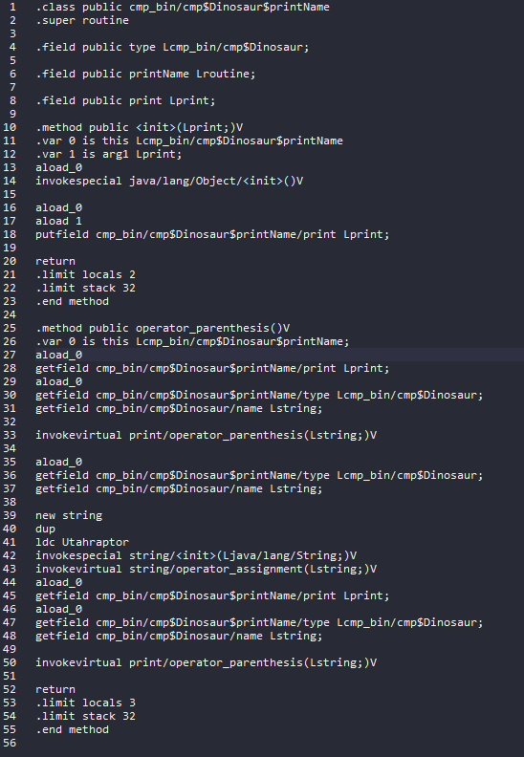
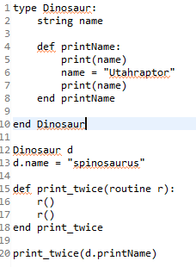
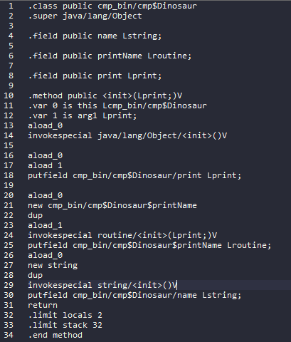
Guide on how to be inefficient:
Dinosaur
printName()
source

Slide 14
Challenges:
Writing everything from scratch
Call semantics
Naming object files
Generating call object code
Meeting the dark god Chernabog during one 3AM programming session
Figuring out how to pass those stupid objects from a outer to an inner scope
And many more!

